Slide 1
Effect of varying weighting factors for various assessment methods
Boris Milašinović
Faculty of Electrical Engineering and Computing, University of Zagreb, Croatia

Slide 2
Motivation
Inspired by some previous work…
Milašinović - Some experiences using various assessments methods with the emphasis on the automatic evaluation of (programming) assignments, Daad workshop in Durres 2008
Predicting students’ grades after 1/3 and 2/3 of the semester
Matetić and Brkić - Analyzing Students' Behavior in a Beginner's Programming Course, Daad workshop in Bansko 2013
Applying data mining techniques on students results
Unusual assessment points distribution (25-4-9-2-25-6)
…and questions
how sure we are in our points distribution?
what would happen if we change assessments weights?

Slide 3
Case study data
Development of Software Applications (DSA)
The 3rd year of bachelor study
Homework: 15 Quizzes: 30
Mid term exam: 20 Final exam: 30
Classroom activity: 5
Development of Information Systems (DIS)
The 1st year of master study
Homework: 25 Quizzes: 20
Mid term exam: 20 Final exam: 25
Classroom activity: 5 Presence at lectures: 5
Minimum threshold
50% for each activity, except for classroom activity and presence at lectures
Data from the last three years
Same weights and same semester organization

Slide 4
How we got those weighting factors?
Are 15 – 30 – 20 – 30 and 25 – 20 – 20 – 25 good ?
for homework, quizzes, mid-term and final exam, for DSA and DIS respectively
How we got them?
Estimating effort for a particular assessment
Mutually comparing values of assessments taking into account type of assessment (homework or classical test, type of tasks)
Rule of the thumb?

Slide 5
What would happen if we had changed those factors?
Many questions
How many grades would change?
What would be average change in total points number?
What about points distribution?
I started analysing current distributions and measure changes for all reasonable combinations
where there is no component with more that 50% of points
excluding classroom activity and presence at lectures
…and soon I wanted to change the title of the presentation to
How I tortured the data and the data refused to cooperate ☺
Notes:
parapgrasing „ If you torture the data long enough, it will confess to anything”
Or parapgrasing „ If you torture the data long enough, nature will confess”
Ronald Coase 1977

Slide 6
Problems in points distributions
Almost none of assessments is normally distributed
It changes slightly (but not too much) if we observe only those above the threshold and if we observe total points distribution
Weak correlations between various assessments
Significant number of students learn just to pass
Many quit after reaching threshold or desired grade
Furthermore, correlations change through years without pattern
Peaks near the threshold
Peaks where the higher grade starts
=> Nightmare for any prediction

Slide 7
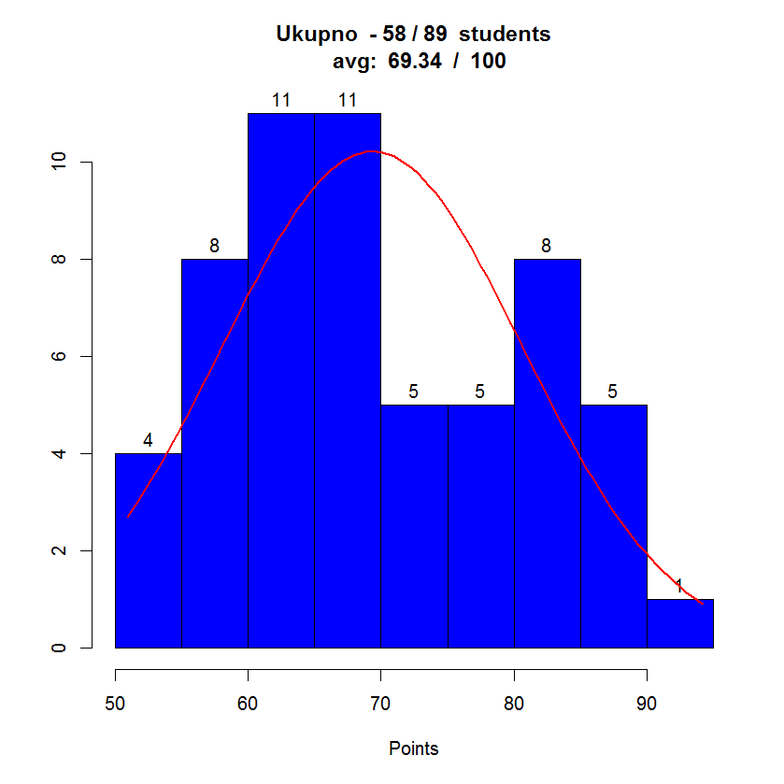
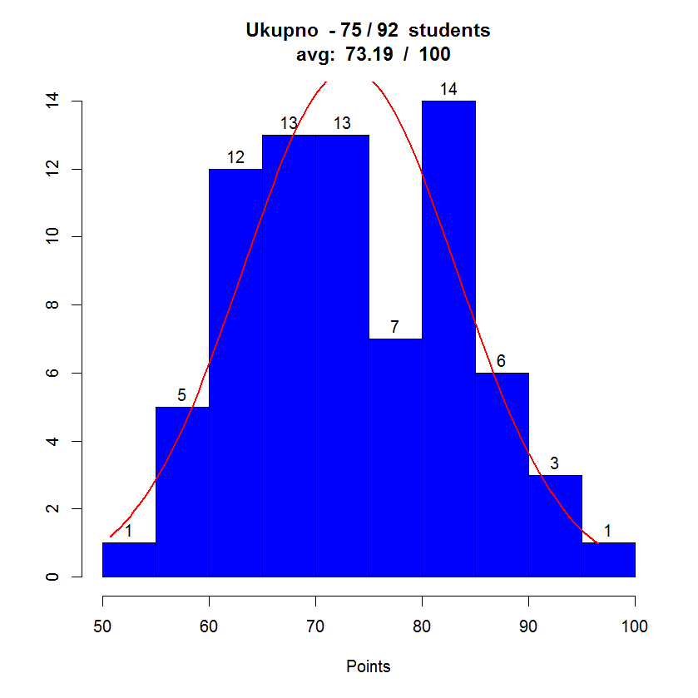
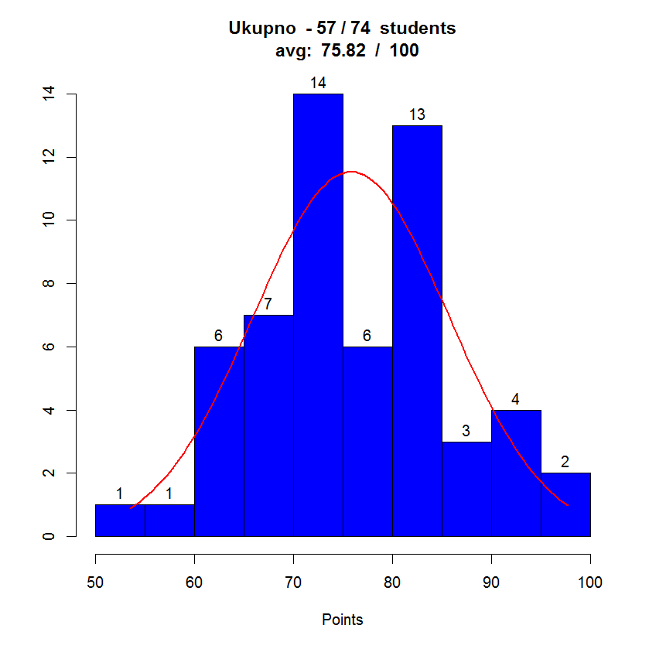
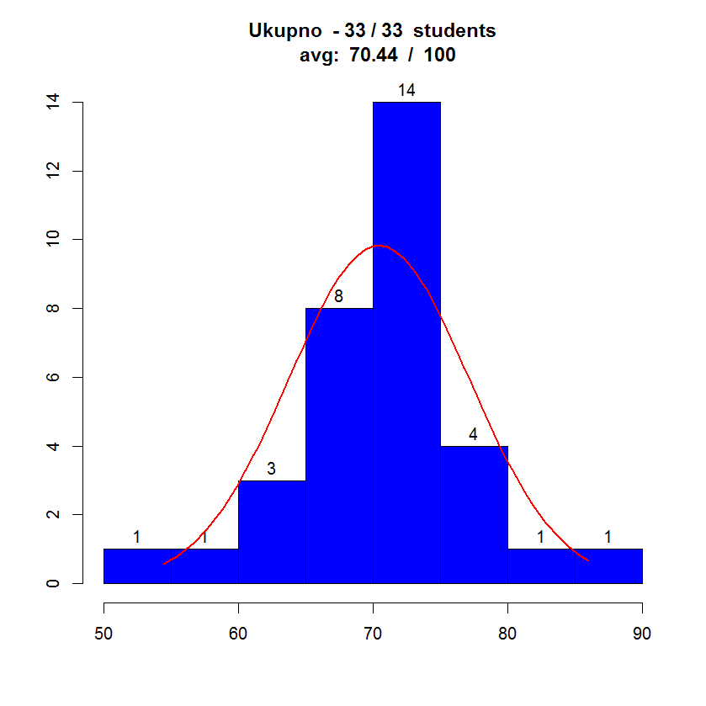
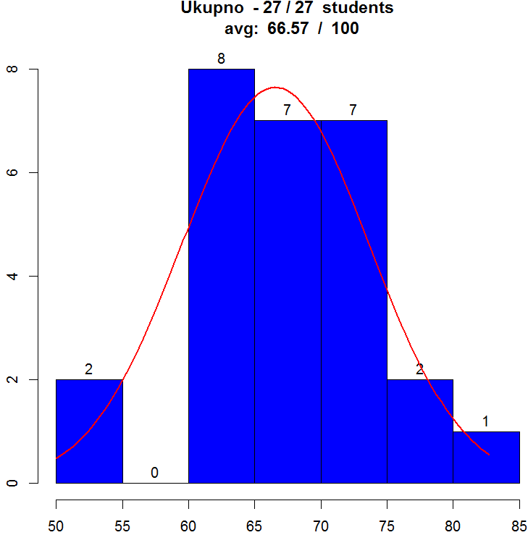
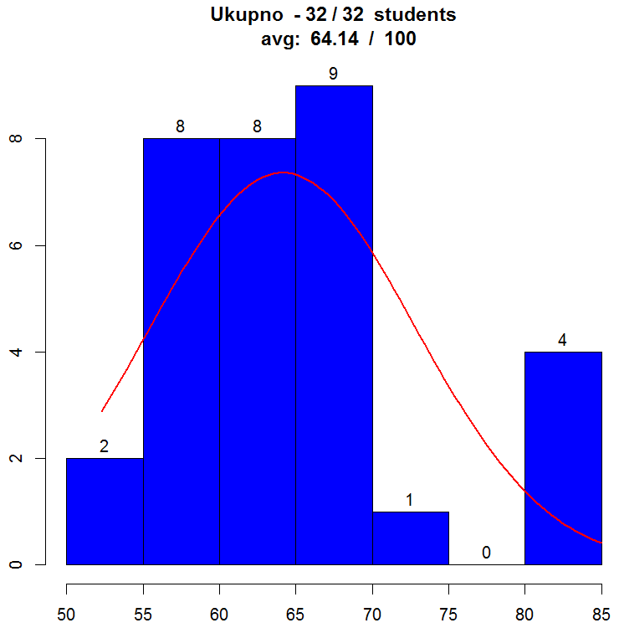
Distributions – Total number of points (Only those students that have passed)
2013
DSA
2012
2014
2014
DIS
2012
2013

Slide 8
Varying weighting factors of assessments
Discarded weights higher than 50 as not reasonable
It would assume that one component is valuable than all others together
Also such weights yield higher number of changes
Combinations with weights from 5 to 50 using 5 as a step
592 combinations for DSA
540 combinations for DIS
Measured for each combination (in comparison to the existing weights distribution)
Average change in student’s total points
Number of grades changed
Maximum change of a single weight
Sum of changes of all weights

Slide 9
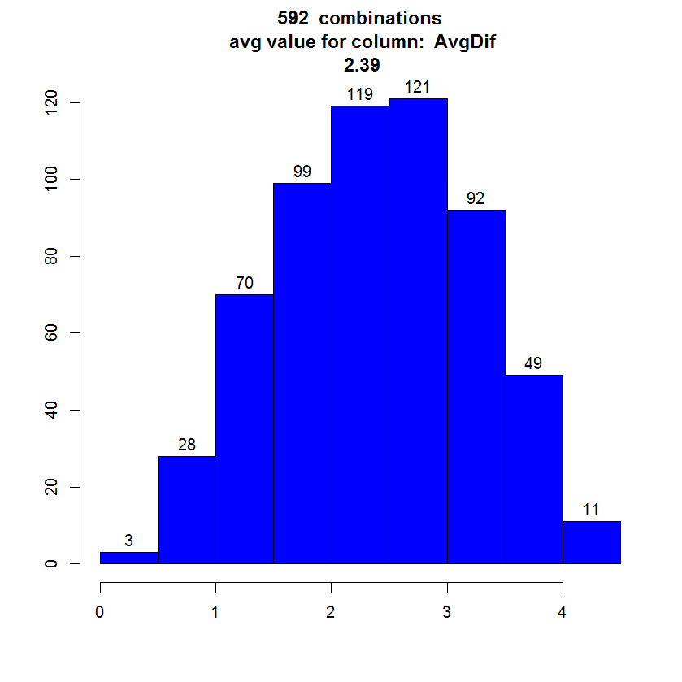
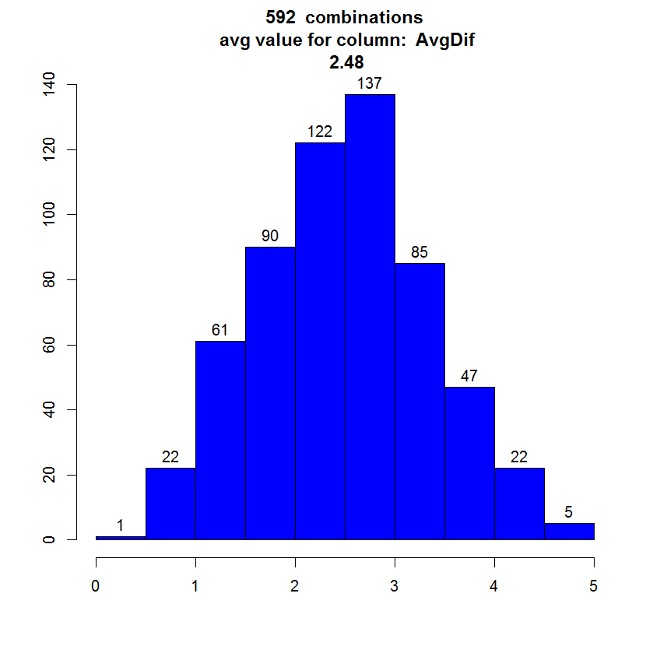
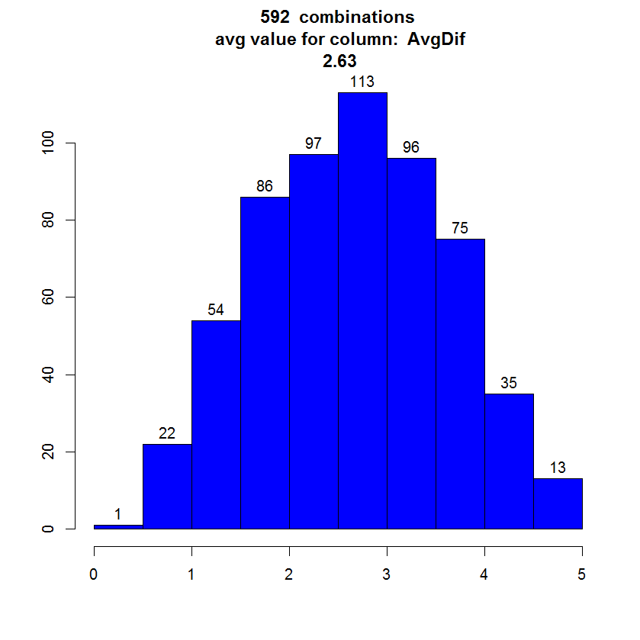
Results for DSA: Average change in total points
X-axis: average change of points for a combination of weighting factors
There is no combination (of 592) that change (in average) total number of points more than 5 points (of 100)
2012
2013
2014

Slide 10
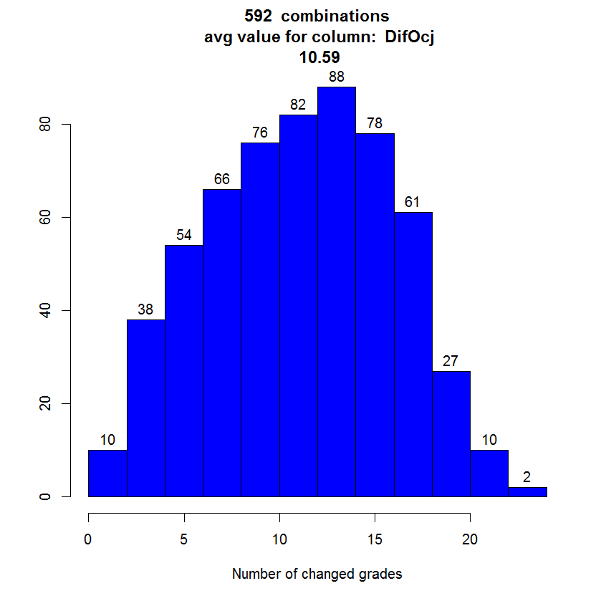
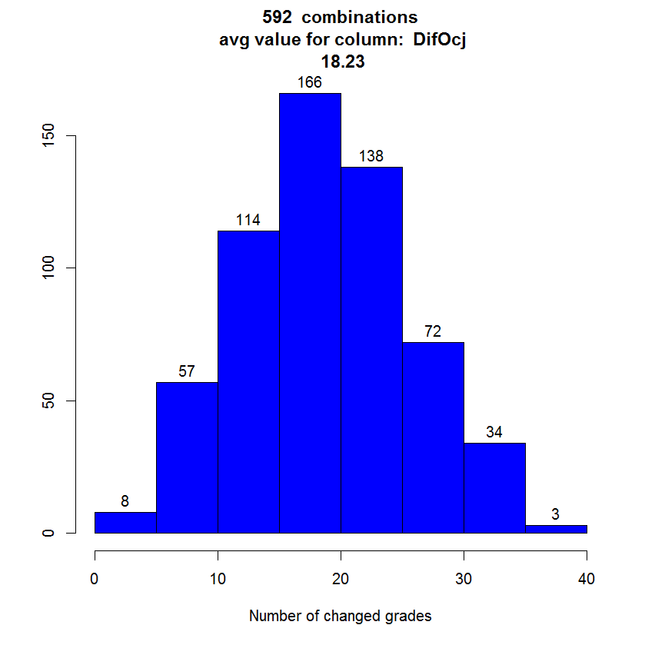
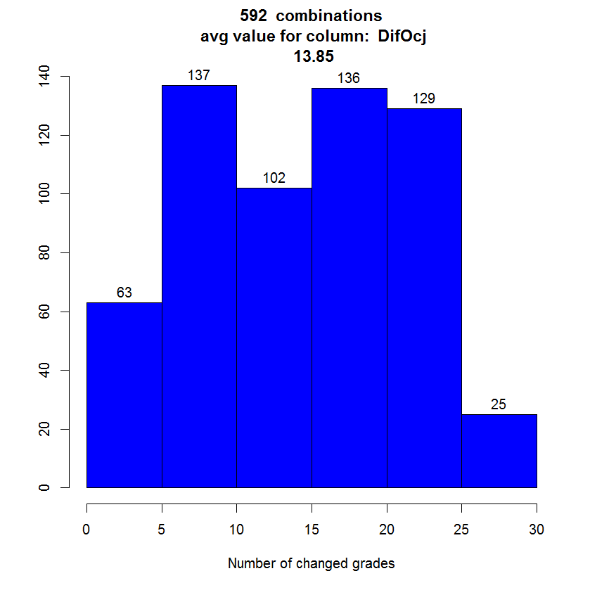
Results for DSA: Changes in grades
X-axis: number of students that would have different grade using a combination of weighting factors
No of students per year: 58 - 75 - 57
In many combinations significant number od students would have different grade but also many combinations produce only minor changes from original grades
2012
2013
2014

Slide 11
Correlations for DSA
2012 | Grade | Avg | MaxDif | WDif | MaxW
Grade |  | 0,73 | 0,73 | 0,68 | 0,69
Avg | 0,73 |  | 0,93 | 0,86 | 0,86
MaxDif | 0,73 | 0,93 |  | 0,88 | 0,78
WDif | 0,68 | 0,86 | 0,88 |  | 0,84
MaxW | 0,69 | 0,86 | 0,78 | 0,84
2013 | Grade | Avg | MaxDif | WDif | MaxW
Grade |  | 0,91 | 0,82 | 0,79 | 0,77
Avg | 0,91 |  | 0,91 | 0,88 | 0,86
MaxDif | 0,82 | 0,91 |  | 0,89 | 0,92
WDif | 0,78 | 0,88 | 0,89 |  | 0,84
MaxW | 0,77 | 0,86 | 0,92 | 0,84
2013 | Grade | Avg | MaxDif | WDif | MaxW
Grade |  | 0,78 | 0,7 | 0,69 | 0,69
Avg | 0,78 |  | 0,95 | 0,88 | 0,83
MaxDif | 0,7 | 0,95 |  | 0,87 | 0,79
WDif | 0,69 | 0,88 | 0,87 |  | 0,84
MaxW | 0,69 | 0,83 | 0,79 | 0,84
Grade
Number of changed grades
Avg
Average change of total points
MaxDif
Highest change of total points
WDif
Sum of absolute difference of weights
MaxW
Maximum single change of weights

Slide 12
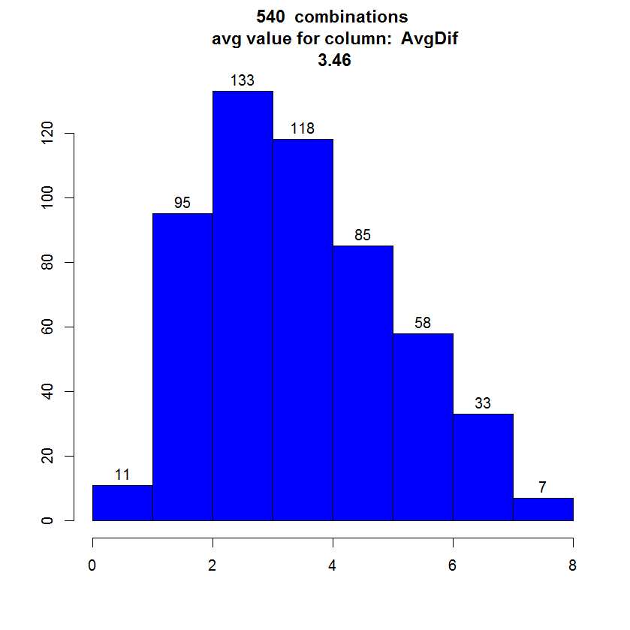
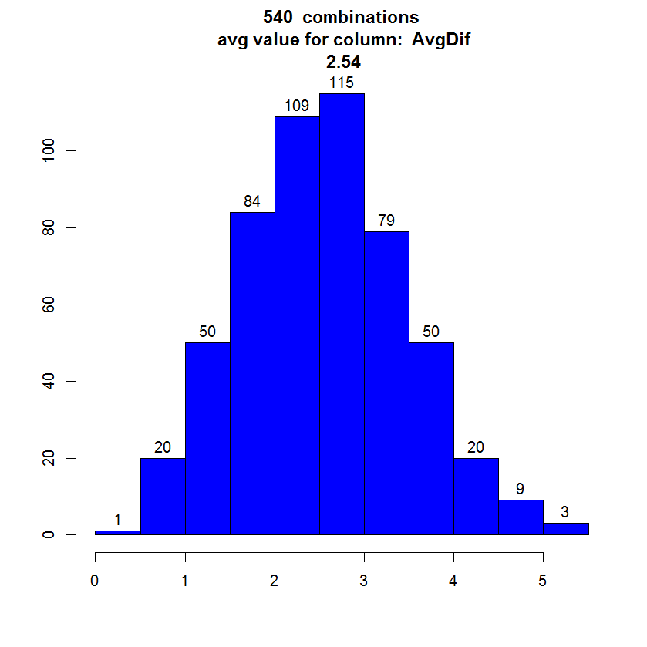
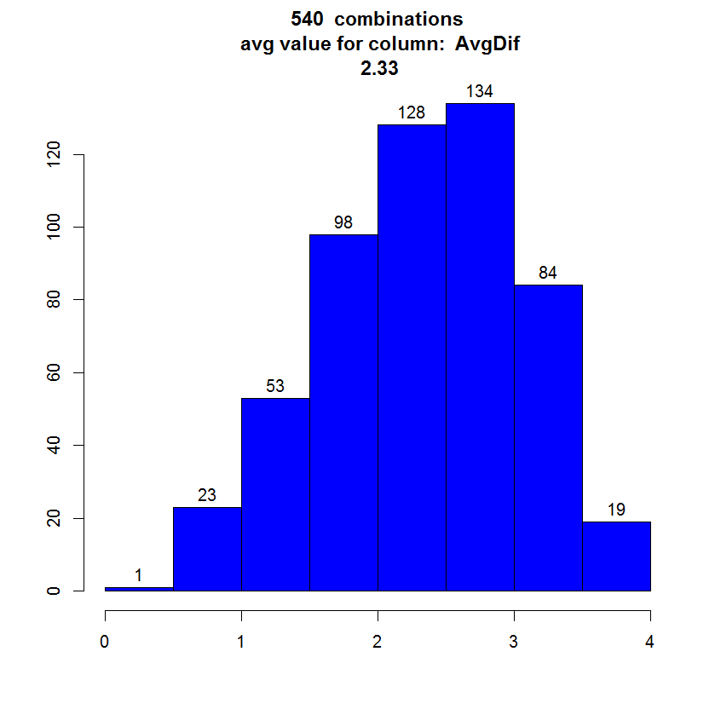
Results for DIS: Average change in total points
In 2013 & 2014 very similar to those from DSA
Little bit higher for year 2012 (up to 8 in average) but only for small number of combinations
2012
2013
2014

Slide 13
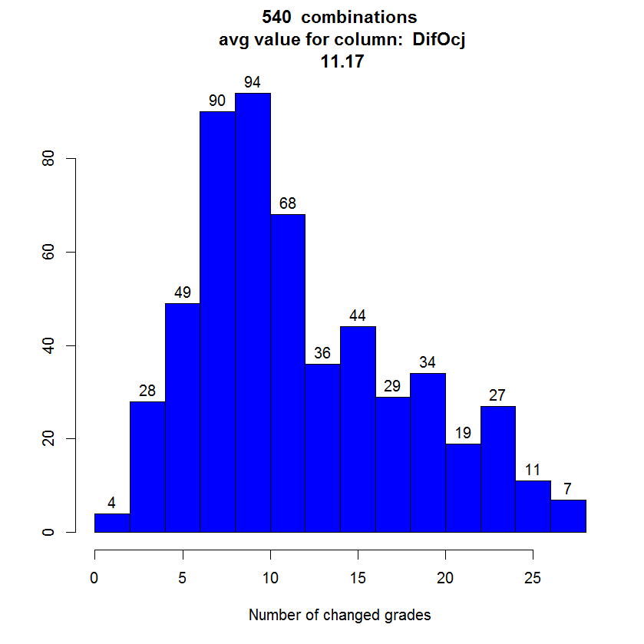
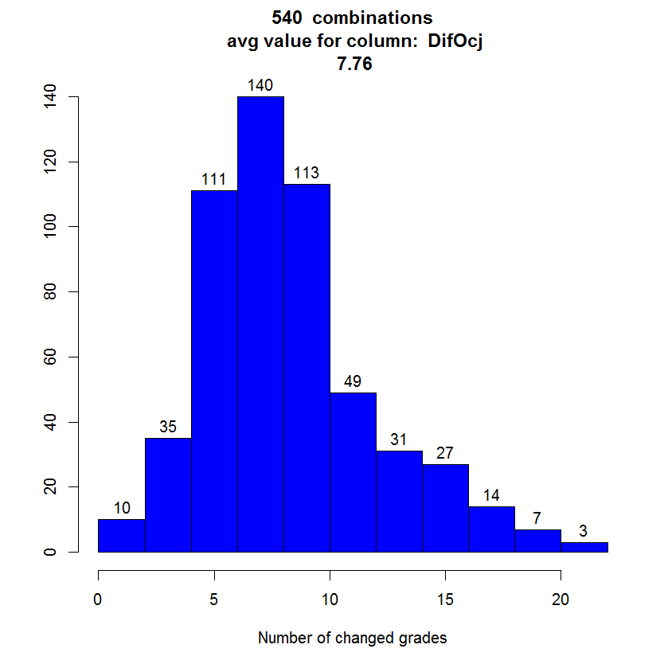
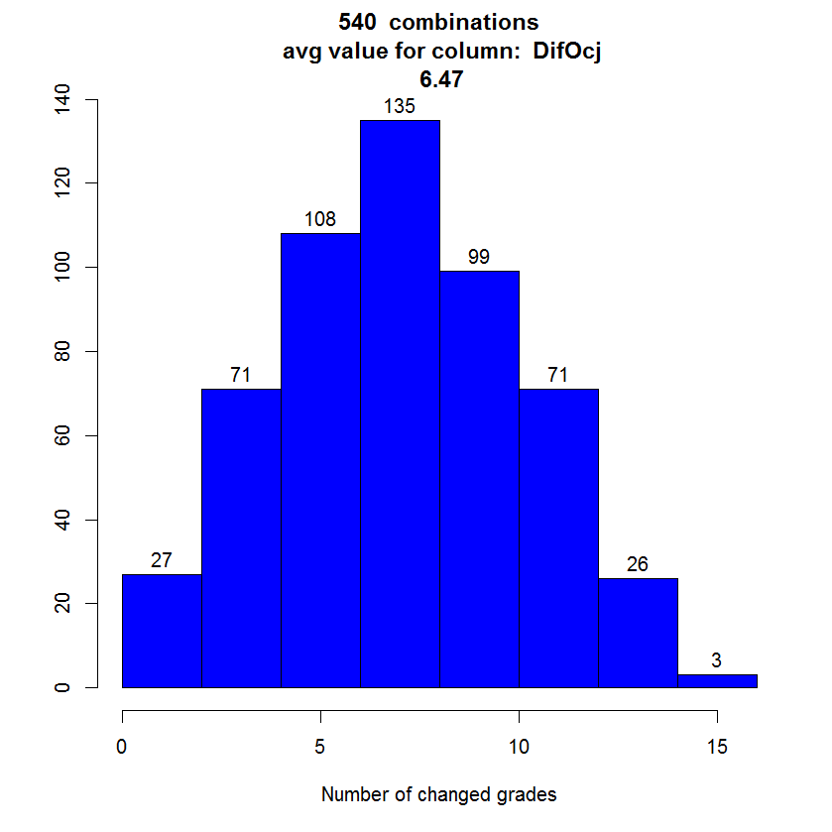
Results for ISD: Changes in grades
X-axis: number of students that would have different grade using a combination of weighting factors
No of students per year 33 – 27 - 32
Relatively to number of students more changes in grades than for DSA but still many combination that change only few grades
2012
2013
2014

Slide 14
Correlations for DIS
2012 | Grade | Avg | MaxDif | WDif | MaxW
Grade |  | 0,74 | 0,67 | 0,56 | 0,47
Avg | 0,74 |  | 0,87 | 0,48 | 0,38
MaxDif | 0,67 | 0,87 |  | 0,5 | 0,39
WDif | 0,56 | 0,48 | 0,5 |  | 0,86
MaxW | 0,47 | 0,38 | 0,39 | 0,86
2013 | Grade | Avg | MaxDif | WDif | MaxW
Grade |  | 0,73 | 0,64 | 0,69 | 0,55
Avg | 0,73 |  | 0,92 | 0,55 | 0,42
MaxDif | 0,64 | 0,92 |  | 0,56 | 0,49
WDif | 0,69 | 0,55 | 0,56 |  | 0,86
MaxW | 0,55 | 0,42 | 0,49 | 0,86
2013 | Grade | Avg | MaxDif | WDif | MaxW
Grade |  | 0,74 | 0,75 | 0,4 | 0,44
Avg | 0,74 |  | 0,92 | 0,54 | 0,53
MaxDif | 0,75 | 0,92 |  | 0,55 | 0,51
WDif | 0,4 | 0,54 | 0,55 |  | 0,86
MaxW | 0,44 | 0,53 | 0,51 | 0,86
Grade
Number of changed grades
Avg
Average change of total points
MaxDif
Highest change of total points
WDif
Sum of absolute difference of weights
MaxW
Maximum single change of weights

Slide 15
Conclusion
Doing comparison to present situation without knowing is the present situation good or bad
An idea was to immediately discard combinations that yields distributions that are not normal
Cannot be done due „original” combination is not near normal distribution
Do we always have to aim toward normal distribution ?
Cannot be done as long as students tend to calculate and have different priorities?
Small average changes in points yield not so small changes of grade
Peeks - significant number of students learn just to pass, stop after achieving points for a grade or ask for additional point or 2
In some other combination of weights they would act differently as it would directly affect the grades
Minor changes in weights (e.g. ±5, even ±10 in some combinations) almost does not have effect
No need to worry if weights are not perfect ?

